Slide 1
Strategies for Taking Standardized Tests

Slide 2
‘Twas the Night Before Testing
Go to bed on time.
Put a few number 2 pencils with erasers in your backpack.
Solve family/friend problems before the testing date.
Talk to your parents about any concerns that you might have about the test.

Slide 3
The Morning of Testing
Start your day as you always do.
Eat a good breakfast.
Think of what you will do to relax after you get home from school.
Think Positive!

Slide 4
Multiple Choice Questions
Do not change your answers unless you are very uncertain about your first answer choice.
Try to answer every question. Make the most intelligent guess you can.
Read the question and all answer choices before marking anything.

Slide 5
The Process of Elimination
After you have been through all of the questions once, go back and find questions you have some knowledge about and eliminate choices that you know are incorrect.
I know C isn’t the answer!

Slide 6
The Process of Elimination
If you can eliminate two wrong answers, your chance of choosing the right answer is greater.

Slide 7
Answering Questions
Don't guess blindly, but if you have time to think about the best answer choice, make it!

Slide 8
Reading Passages
If the test requires you to read passages and then answer questions about what you read,
read the questions first.
By doing this, you will know what you are looking for as you read. This also helps you go faster on the test.

Slide 9
Reading Passages
When there are several questions about a reading passage or chart, look for clues in other questions that will help you with those items about which you are unsure.

Slide 10
Math Computation
When using scratch paper on a math test, double check to make sure that you have copied the problem correctly from the test booklet!

Slide 11
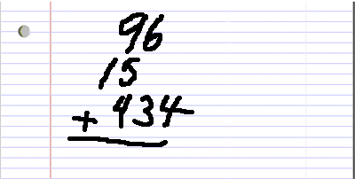
Math Computation
Line up place value correctly on your scratch paper (thousands, hundreds, tens, ones) or the answer will be incorrect.

Slide 12
Math Computation
If your answer does not match one of the choices, reread the problem, recopy the numbers, and try solving it again.

Slide 13
A Matter of Time
You will have plenty of time to take the test. Don’t rush! When time runs out, you will be given more time if you need it and if you have been working hard.

Slide 14
Final Tips
Fill in bubbles fully, write neatly, and erase stray marks.
Double-check the test number in your test booklet against the answer sheet every few questions to be sure you haven’t gotten on the wrong number.

Slide 15
The Death Grip
If your arm tires during testing it is probably due to the grip that you have on your pencil.
Relax the grip and give those muscles a break.

Slide 16
Thank you, Mr. Know-it-all!
Remember it's okay not to know everything — unlike class tests, these tests will have some questions designed to challenge the limits of your knowledge at a grade level above your current grade.

